Slide 1
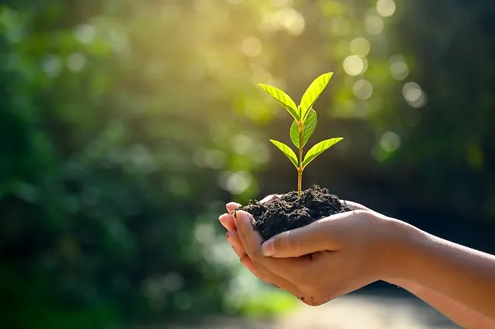
GREEN TERPS – LET’S BRING THE CHANGE !
It is a partnership initiative between the Office of Sustainability and the Department of Resident Life at the University of Maryland.
Spanning from Fall 2018 to Spring 2023, the program aimed to promote environmentally responsible choices among UMD students.
GREEN TERPS –
LET’S BRING THE CHANGE !

Slide 2
GREEN TERPS – LET’S BRING THE CHANGE !
It is a partnership initiative between the Office of Sustainability and the Department of Resident Life at the University of Maryland.
Spanning from Fall 2018 to Spring 2023, the program aimed to promote environmentally responsible choices among UMD students.
GREEN TERPS –
LET’S BRING THE CHANGE !

Slide 3
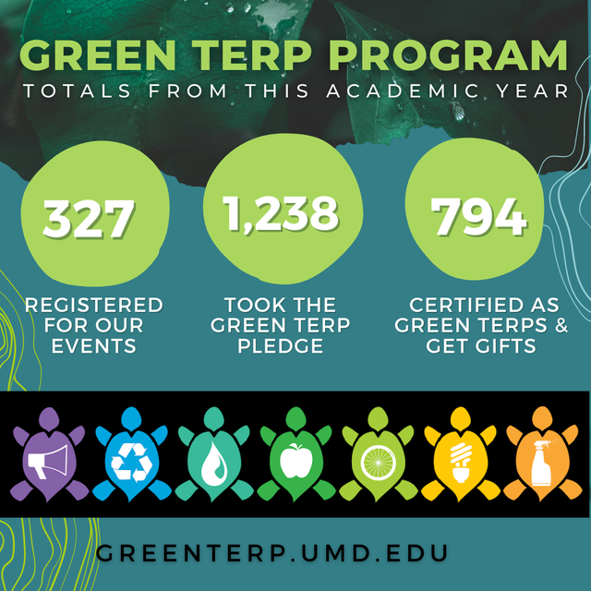


Green Terp Program
Let's look at how UMD has organized their participants and look at how many students are in this program.

Slide 4
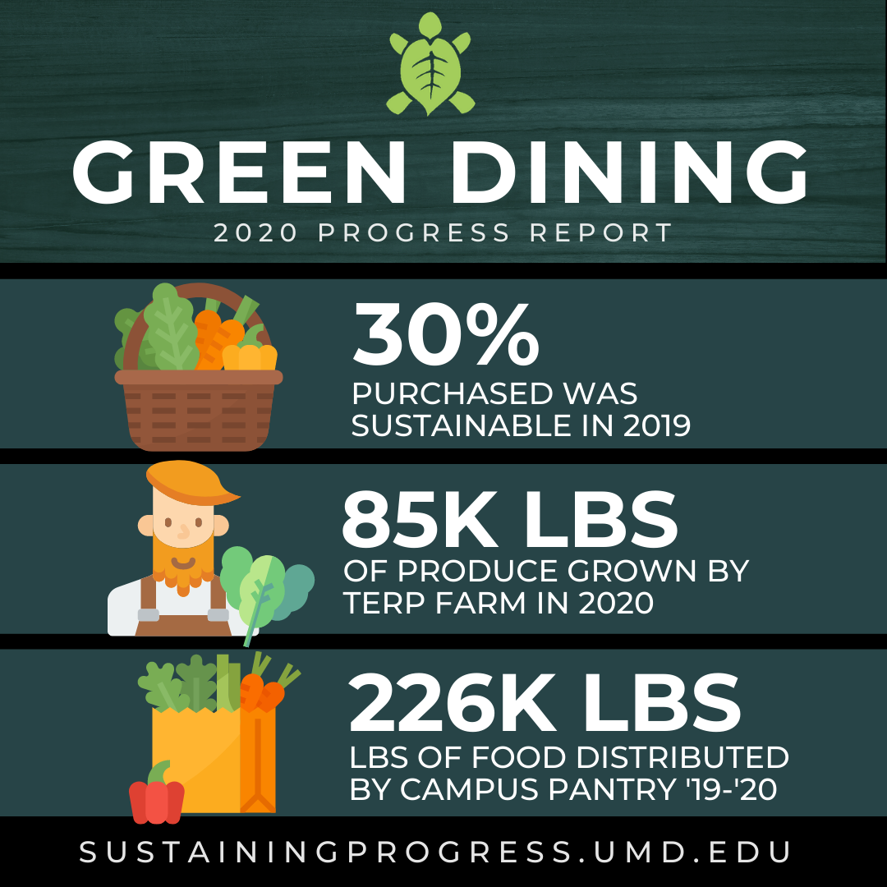

Green Terp Program
Let's look at how UMD has organized their participants and look at how many students are in this program.
In 2021, this was how the program did

Slide 5
Green Terp Program
Let's look at how UMD has organized their participants and look at how many students are in this program.
These are the habits the program wants to see
In 2021, this was how the program did

Slide 6
Green Terp Program
Data from 2019-2020
These are the habits the program wants to see
The program is year long event. Participation is by filling google forms.
Students participate by filling registration form, committing to adopt at least 10 sustainable habits.
One year after registering, students receive a certification google form , where they affirm the incorporation of their pledged behaviors.
This study will analyze the self-reported data to explore student engagement and behavioral change.

Slide 7
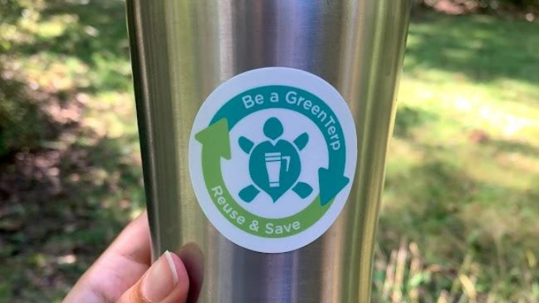

The Program !
GREEN TERPS – LET’S BRING THE CHANGE !
It is a partnership initiative between the Office of Sustainability and the Department of Resident Life at the University of Maryland.
Spanning from Fall 2018 to Spring 2023, the program aimed to promote environmentally responsible choices among UMD students.
The program is year long event. Participation is by filling google forms.
Students participate by filling registration form, committing to adopt at least 10 sustainable habits.
One year after registering, students receive a certification google form , where they affirm the incorporation of their pledged behaviors.
This study will analyze the self-reported data to explore student engagement and behavioral change.
Two key steps to process are registration then certification
Main Challenges :
Students register for the program but are not participating in the certification. The certification rate is very low. What can we do to make the registration and certification ratio 1:1 ?
The are certifications without registration! How ?
The registration rate throughout the years have reduced. What
can be done to increase registrations?

Slide 8
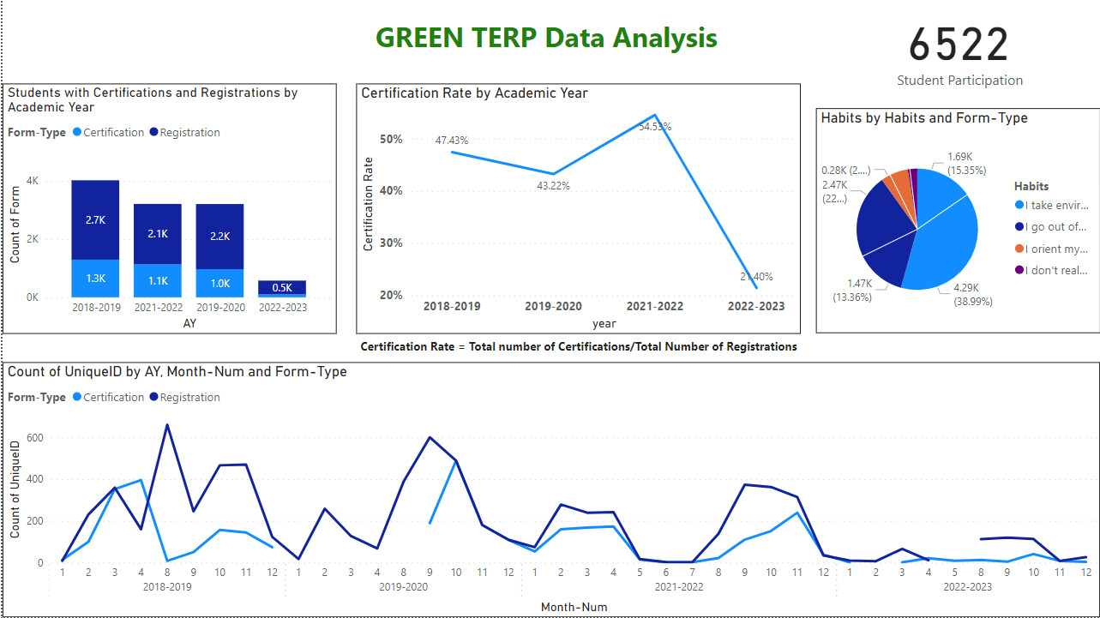

Two key steps to process are registration then certification
The Program !
Main Challenges :
Students register for the program but are not participating in the certification. The certification rate is very low. What can we do to make the registration and certification ratio 1:1 ?
The are certifications without registration! How ?
The registration rate throughout the years have reduced. What
can be done to increase registrations?
The program is year long event. Participation is by filling google forms.
Students participate by filling registration form, committing to adopt at least 10 sustainable habits.
One year after registering, students receive a certification google form , where they affirm the incorporation of their pledged behaviors.
This study will analyze the self-reported data to explore student engagement and behavioral change.

Slide 9
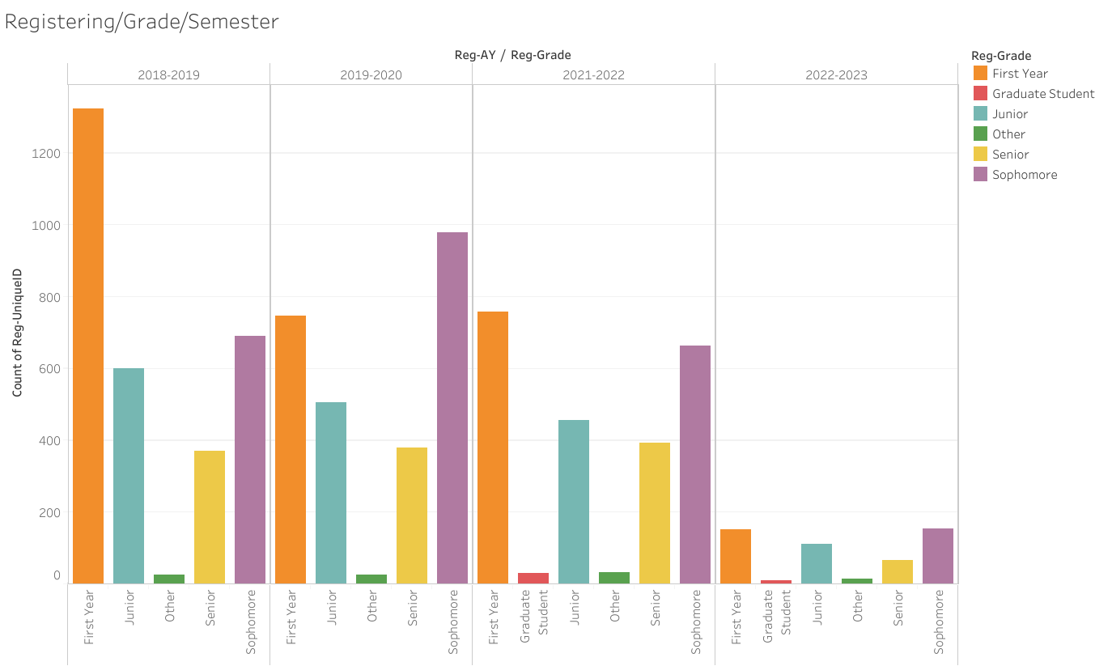
Registration
for each
Grade every
Year
Let's talk about Registration

Slide 10
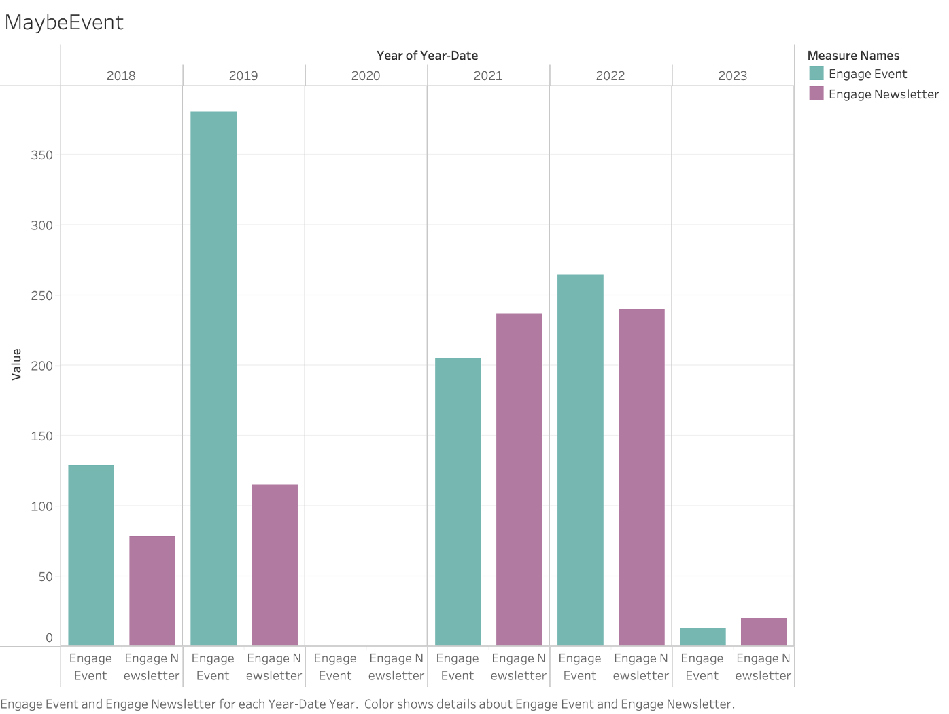
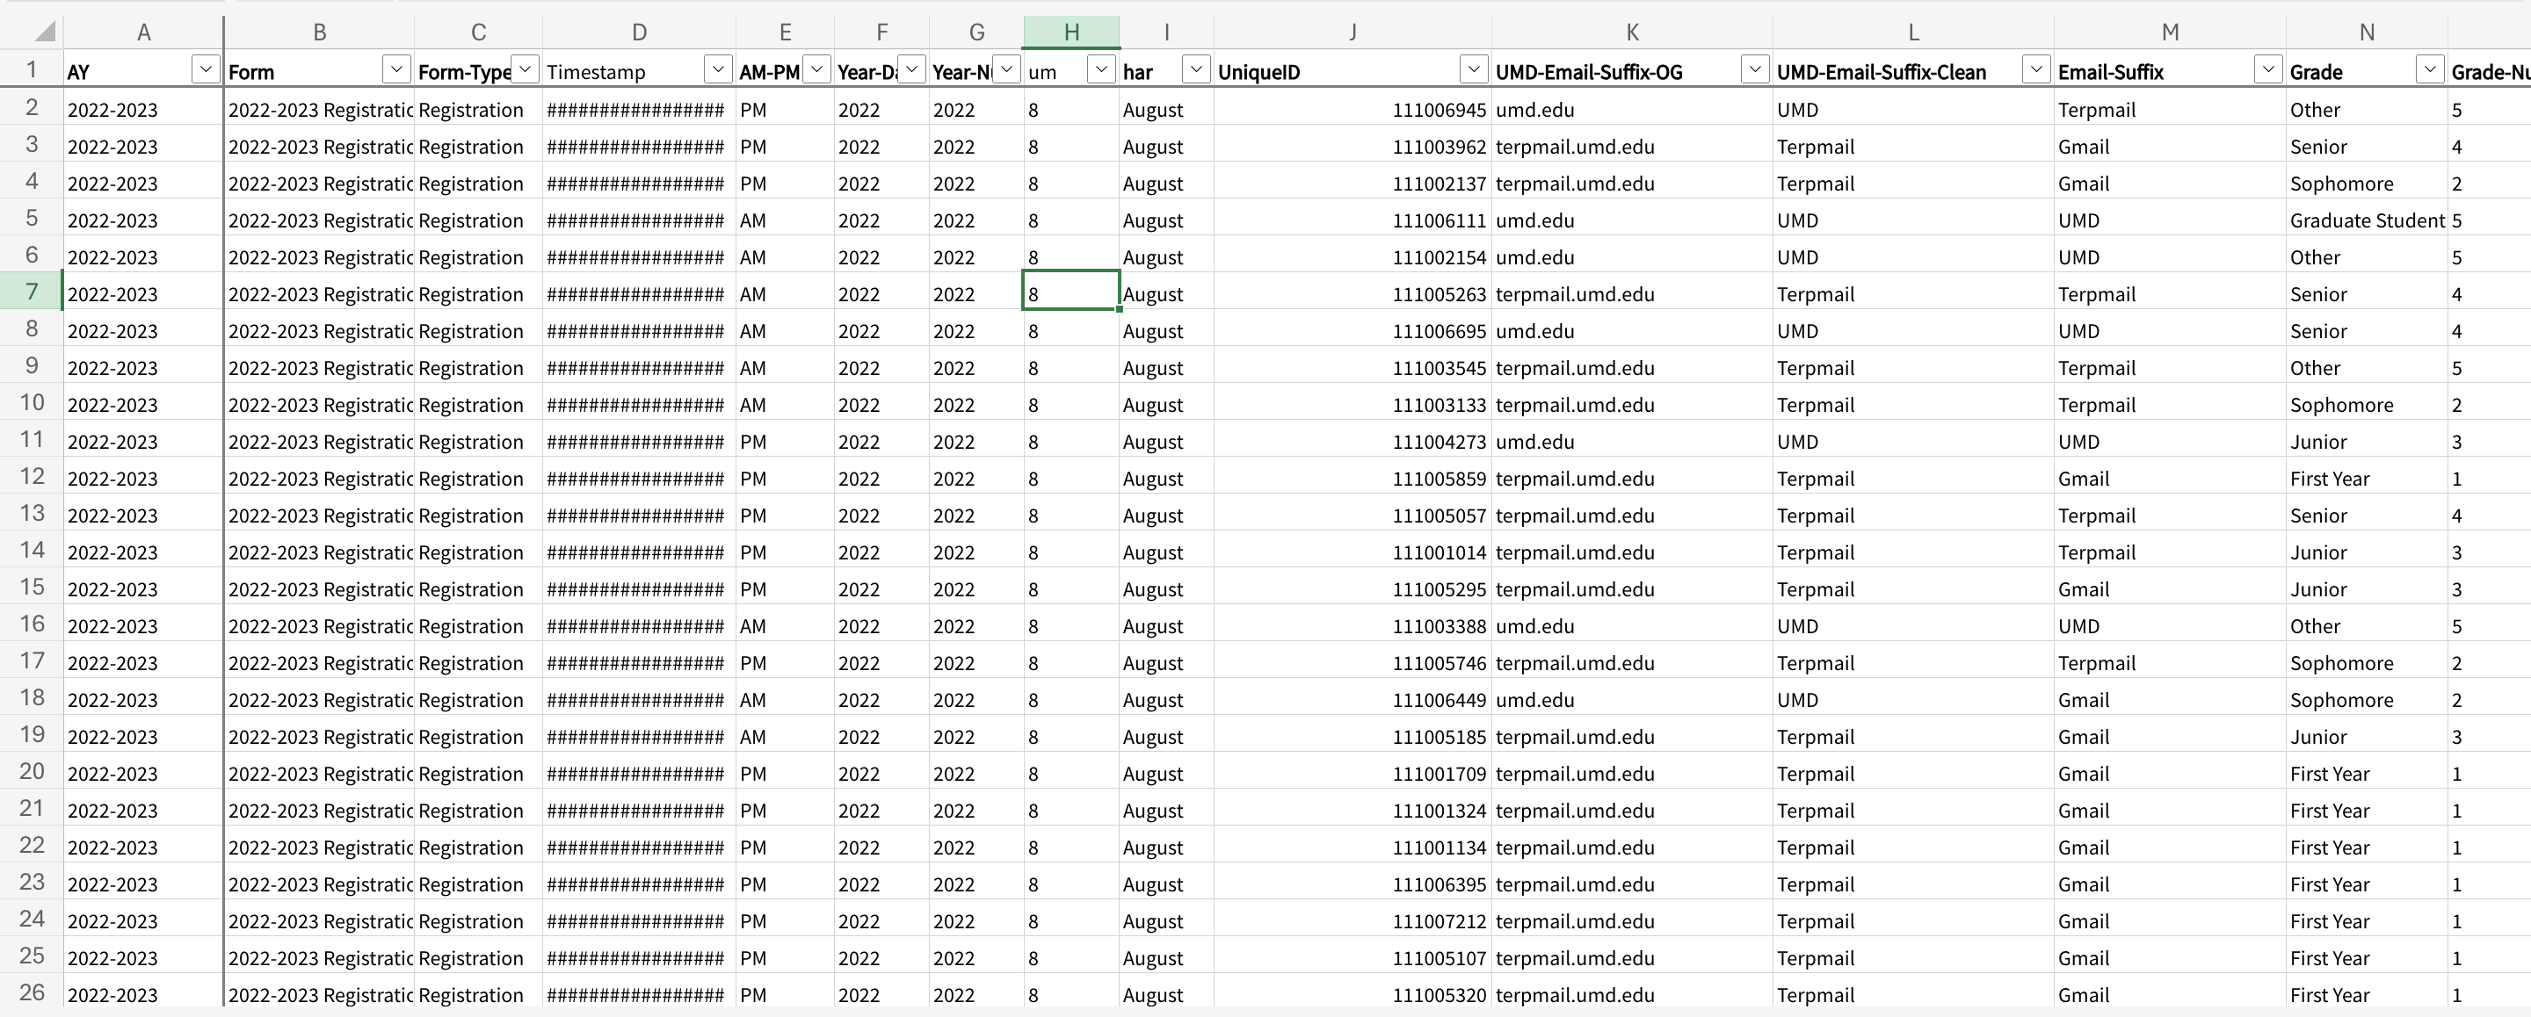
Green Terp Program
Registration
for each
Grade every
Year
Let's talk about Registration
Let's Dive in

Slide 11
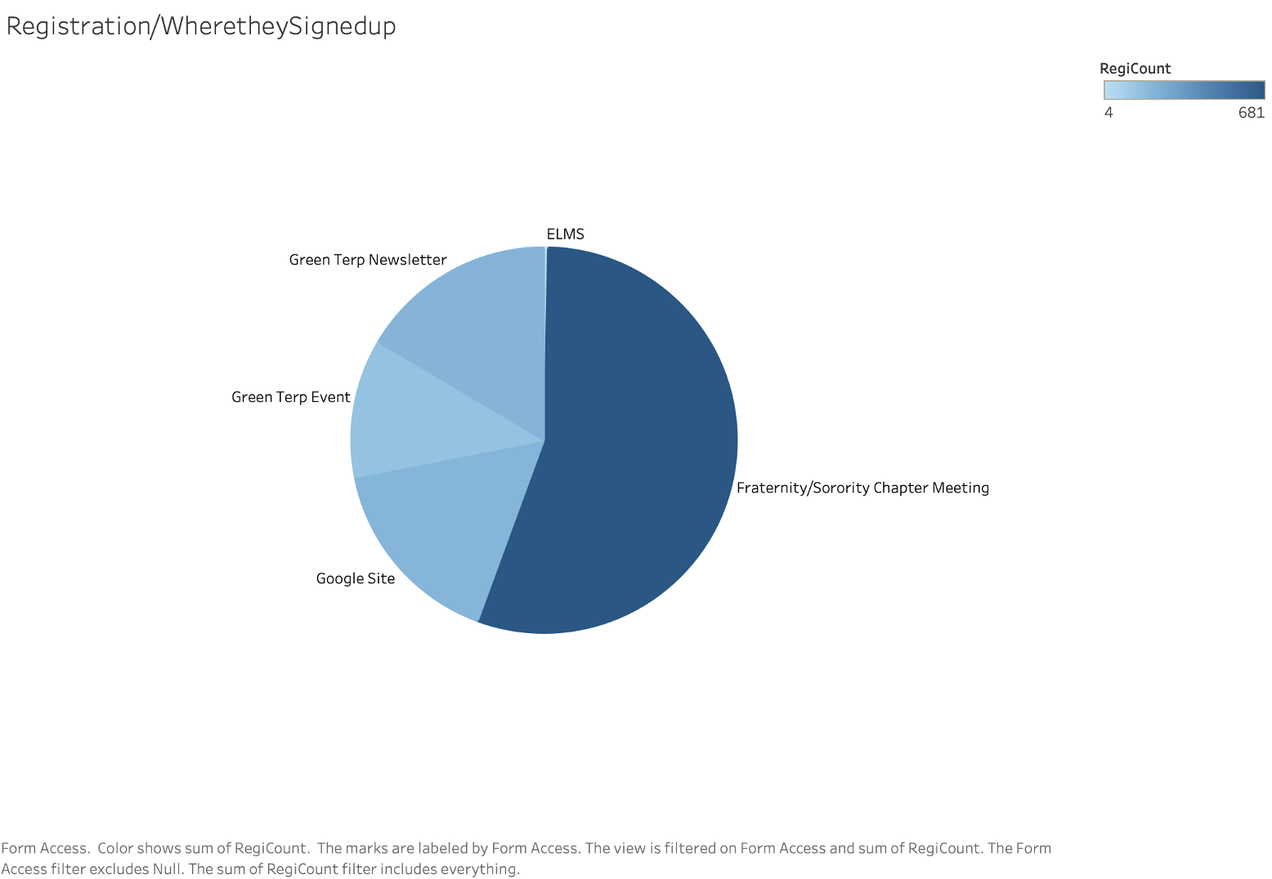

Green Terp Program
How is the engagement in the program?
It declined!
How can we improve it?
Let's Dive in

Slide 12
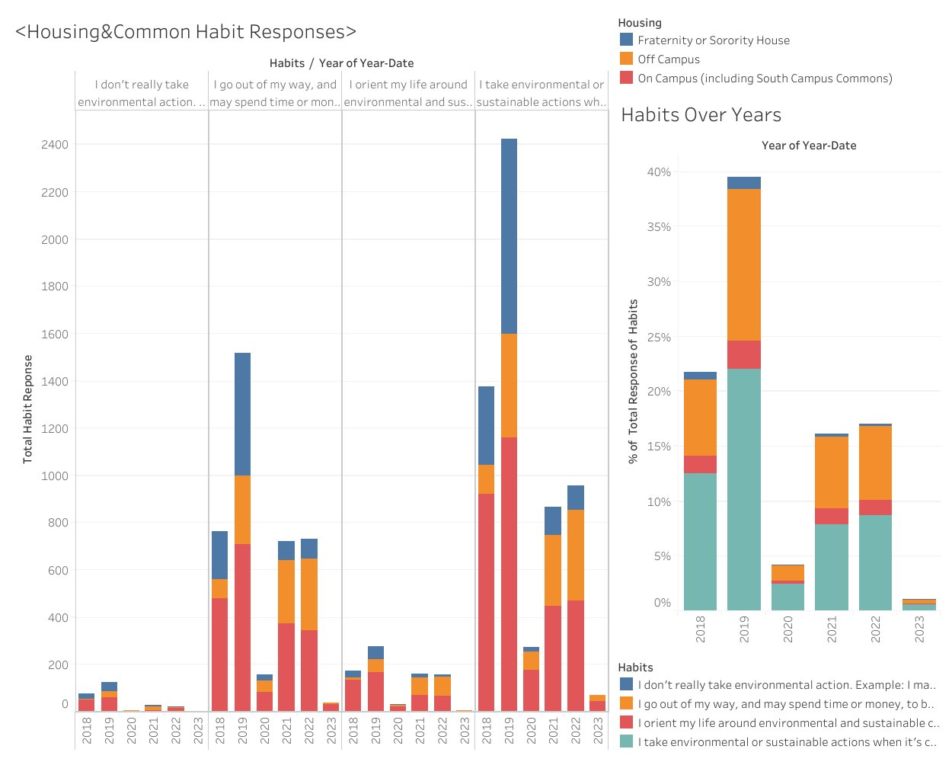
How did they know about Green Terp?
Who are the targeted audience ?

Slide 13
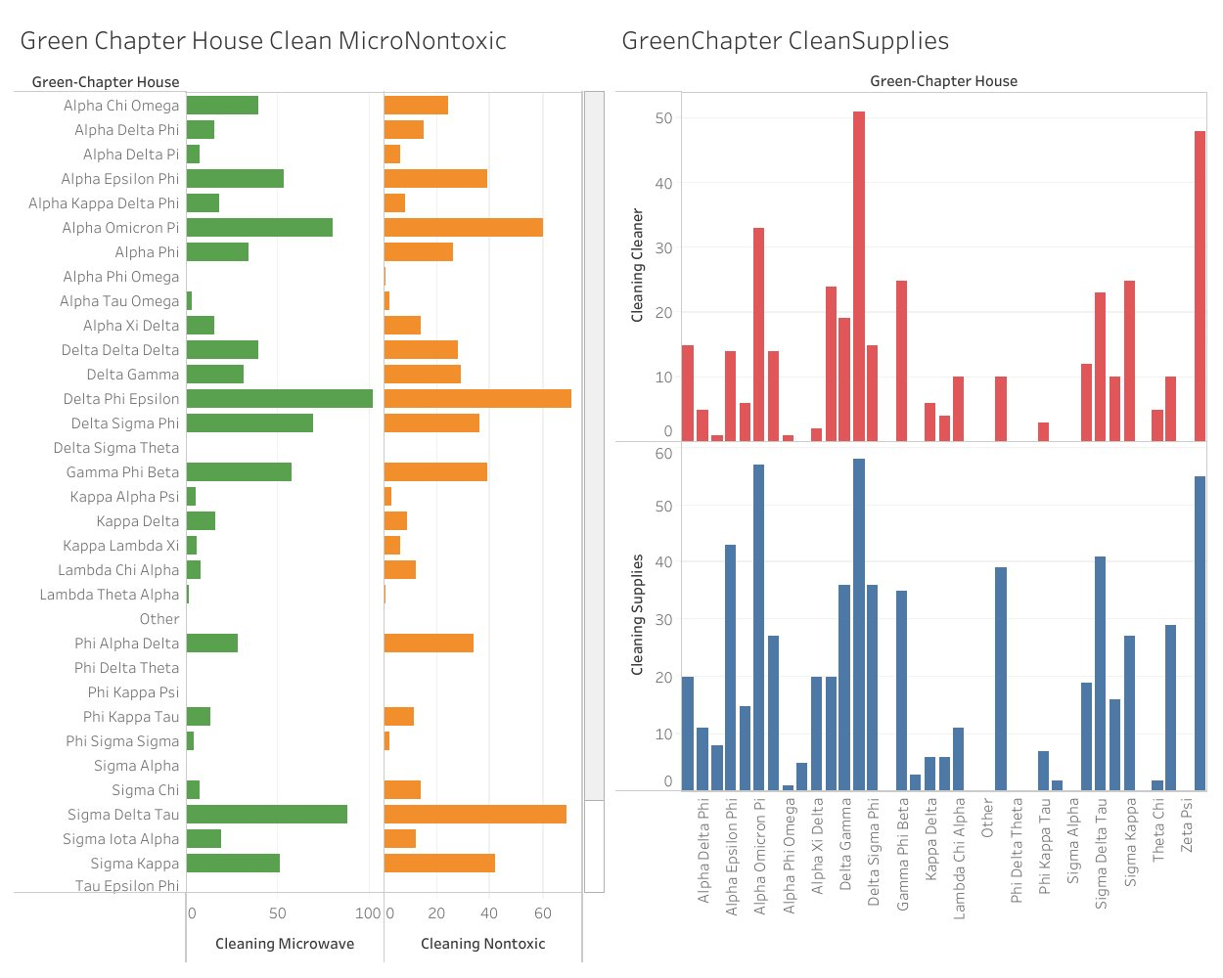
What habits did the students pick the most? Let’s check based on where they live!
What type of habits did they pledge to follow?

Slide 14
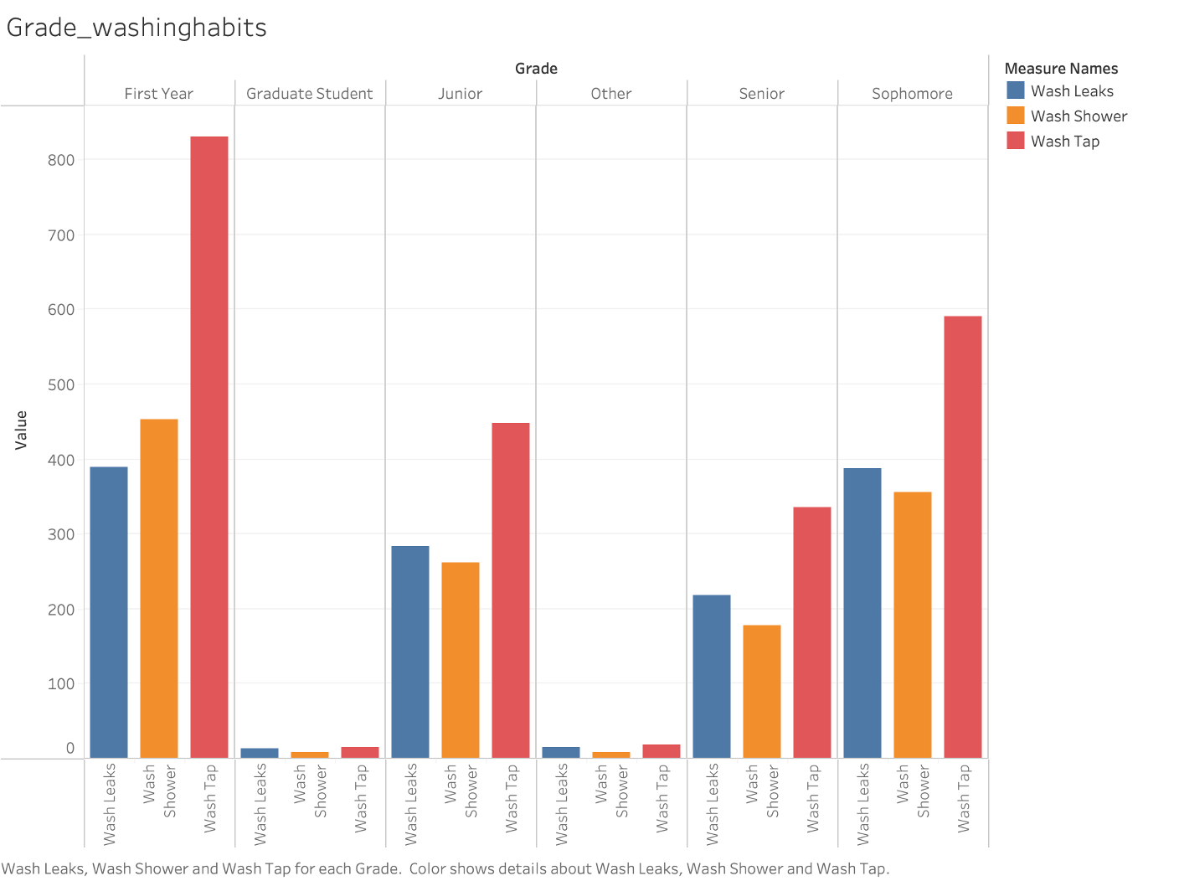
Can you live a sustainable clean life?
Greek life, more like green life.

Slide 15
How is the washing habits for each grade?
What did they do for the cause?

Slide 16
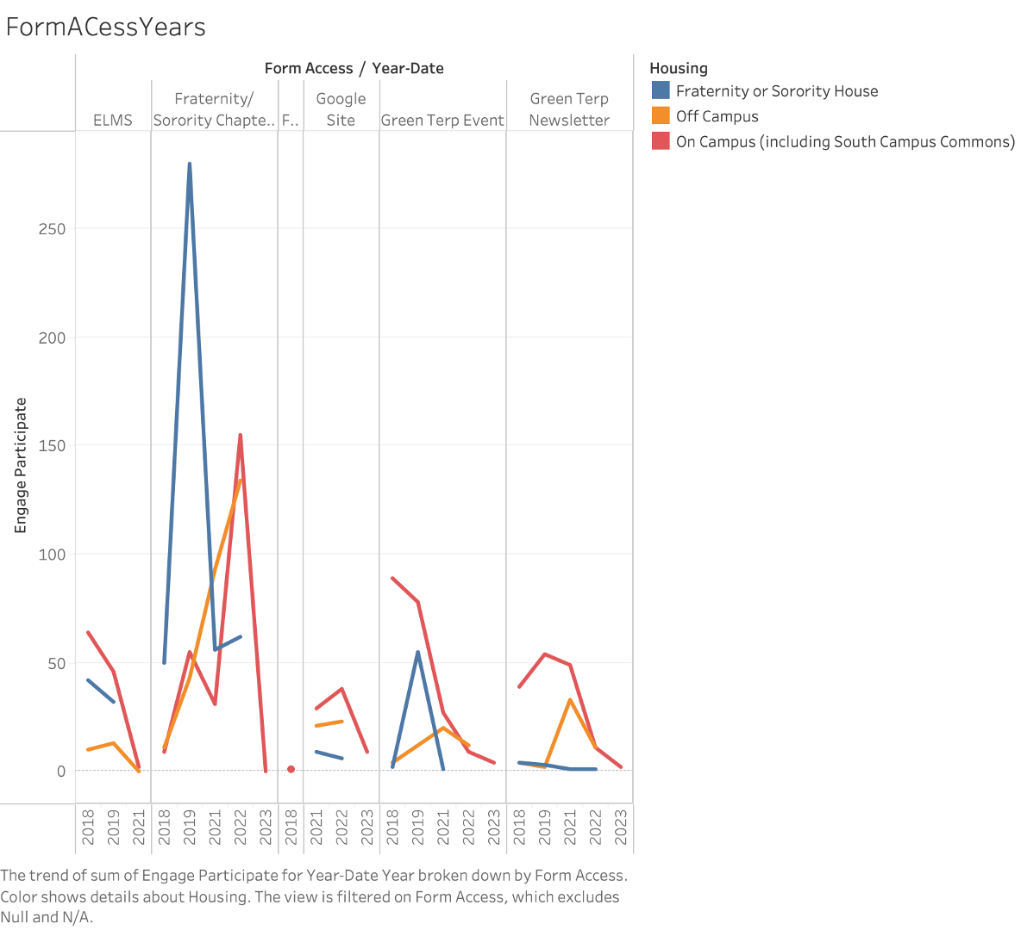
Problems we identified.
Demographics, Who are we targeting.
Who should we be targeting?
Notes:
Not reading, Saying: After analyzing the data we notice there are certain groups of people that are missing out or not targeted. We see a lot of our Greek Life are much more active in completing and registering then other regular students We also see Freshman and Sophomores are more caring about our school while the upperclassmen have basically given up on the campus.

Slide 17
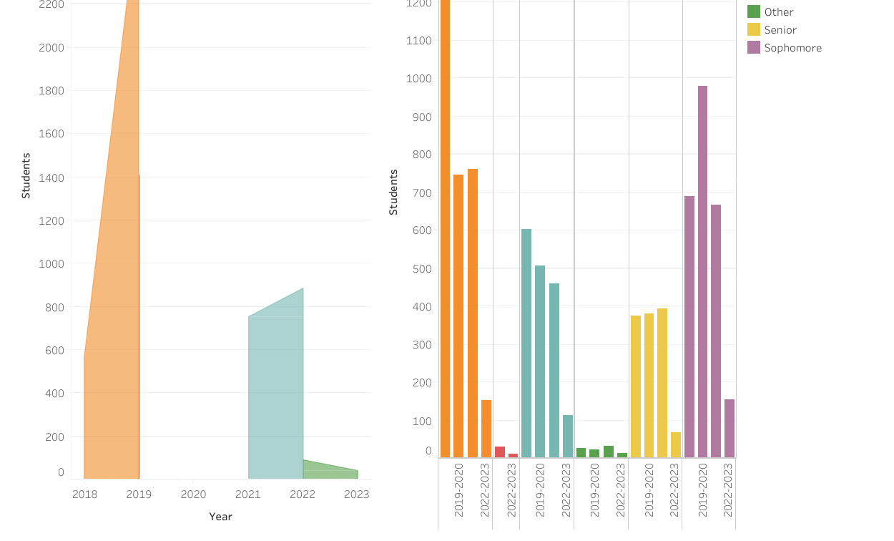

Slide 18
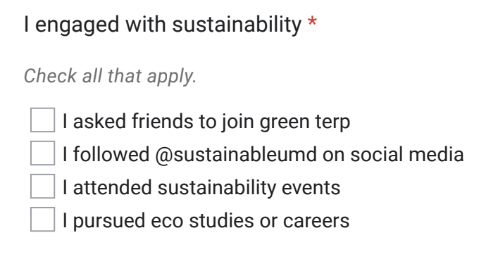
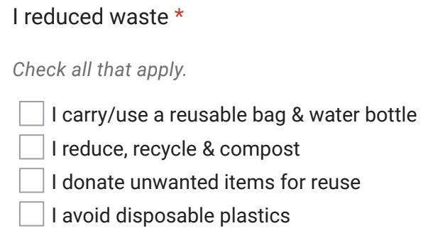
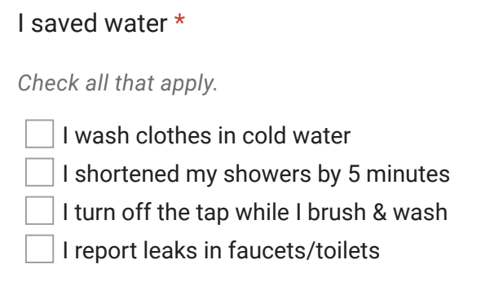
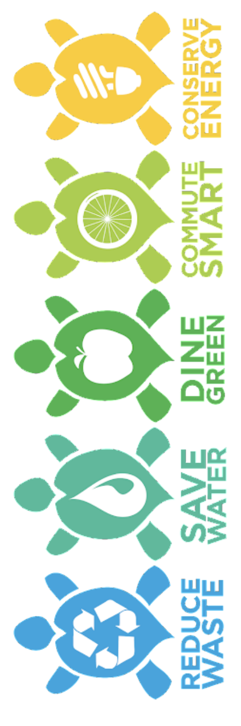
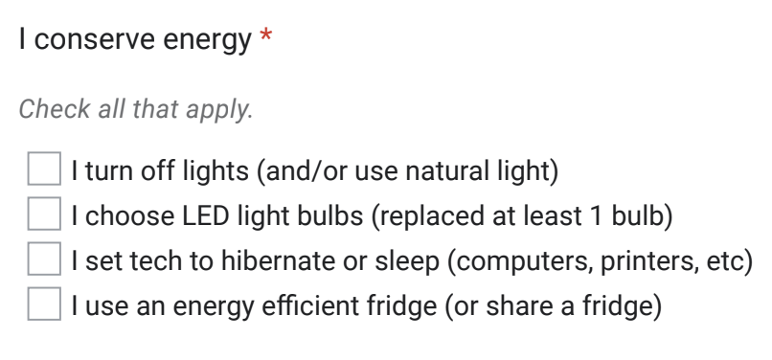
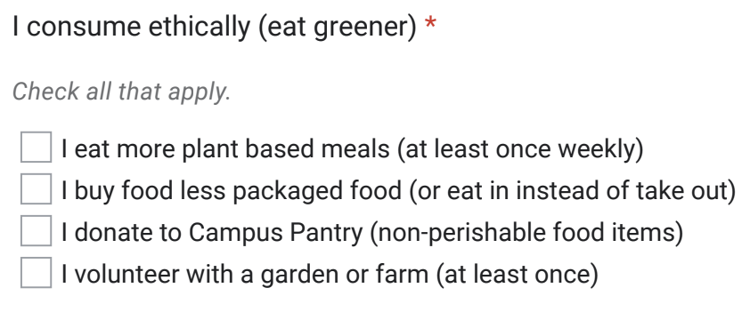
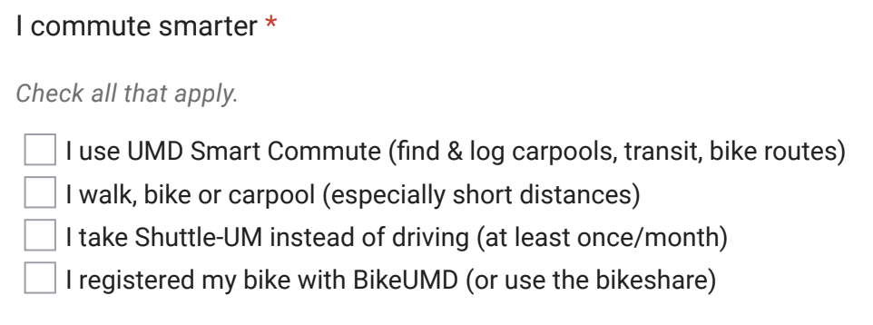
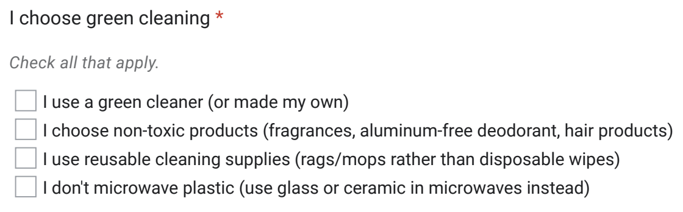

Slide 19
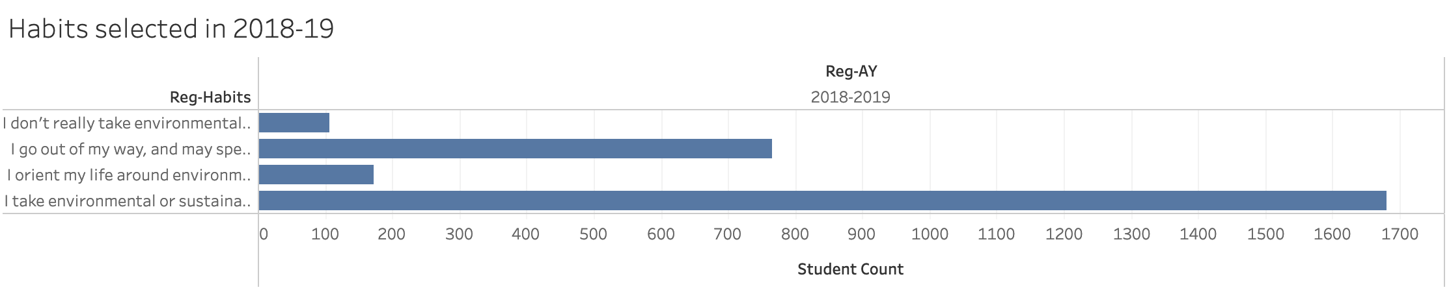
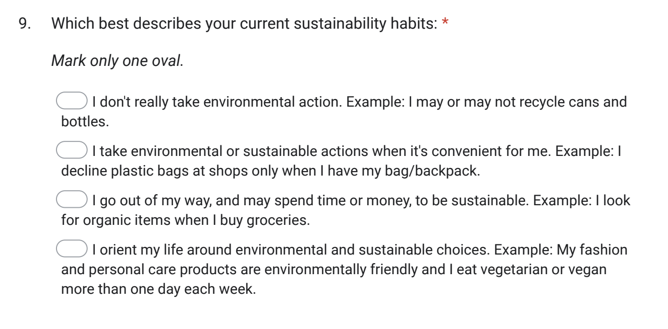
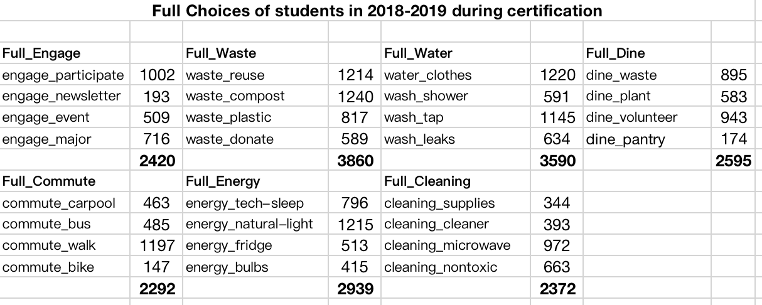
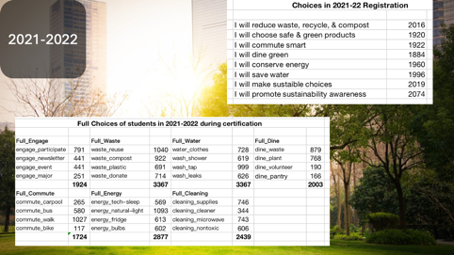
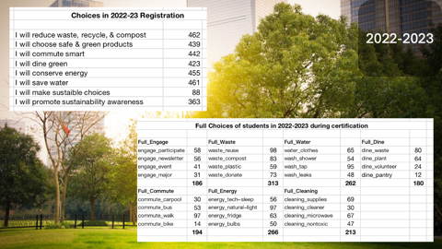
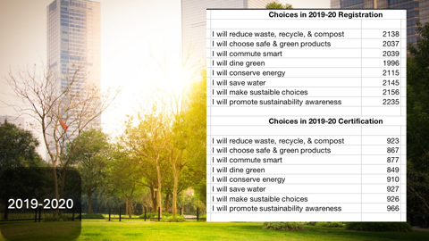
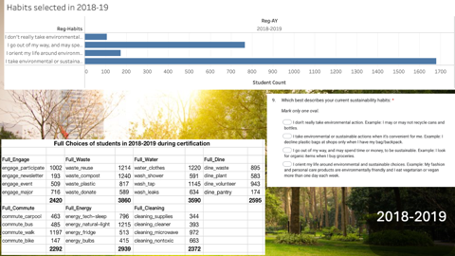

Slide 20

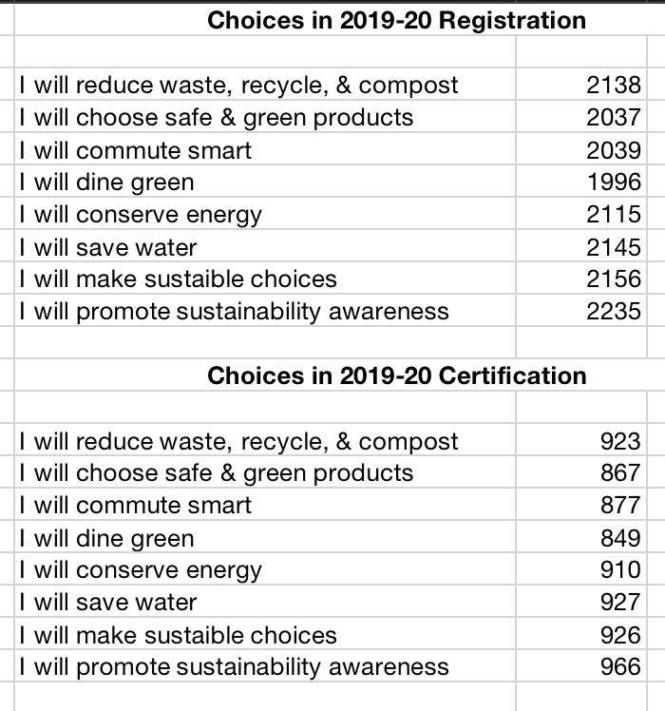
2018-2019

Slide 21
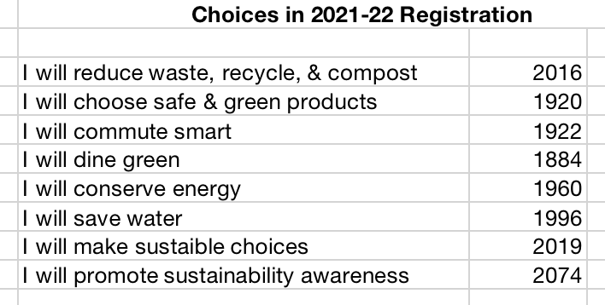
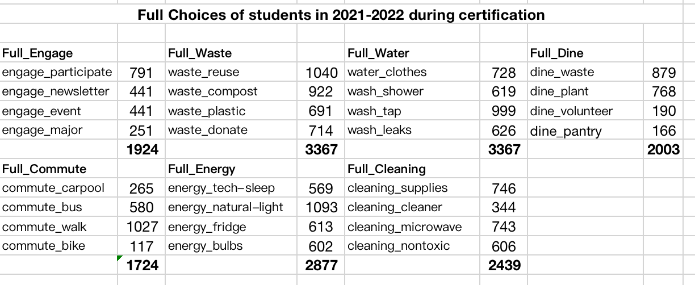
2019-2020

Slide 22
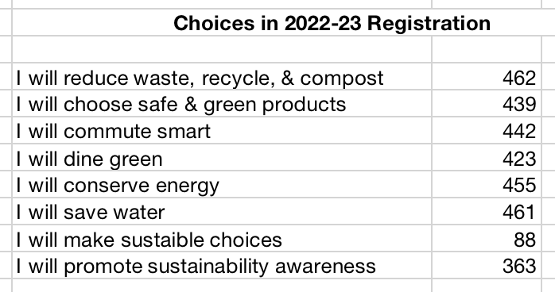
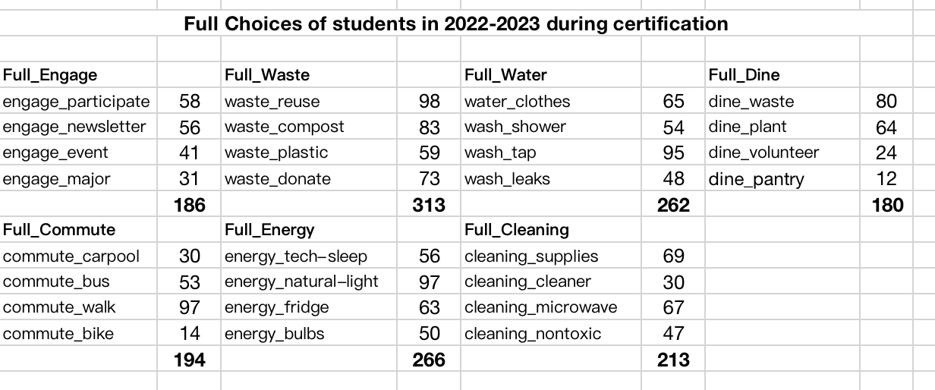
2021-2022

Slide 23
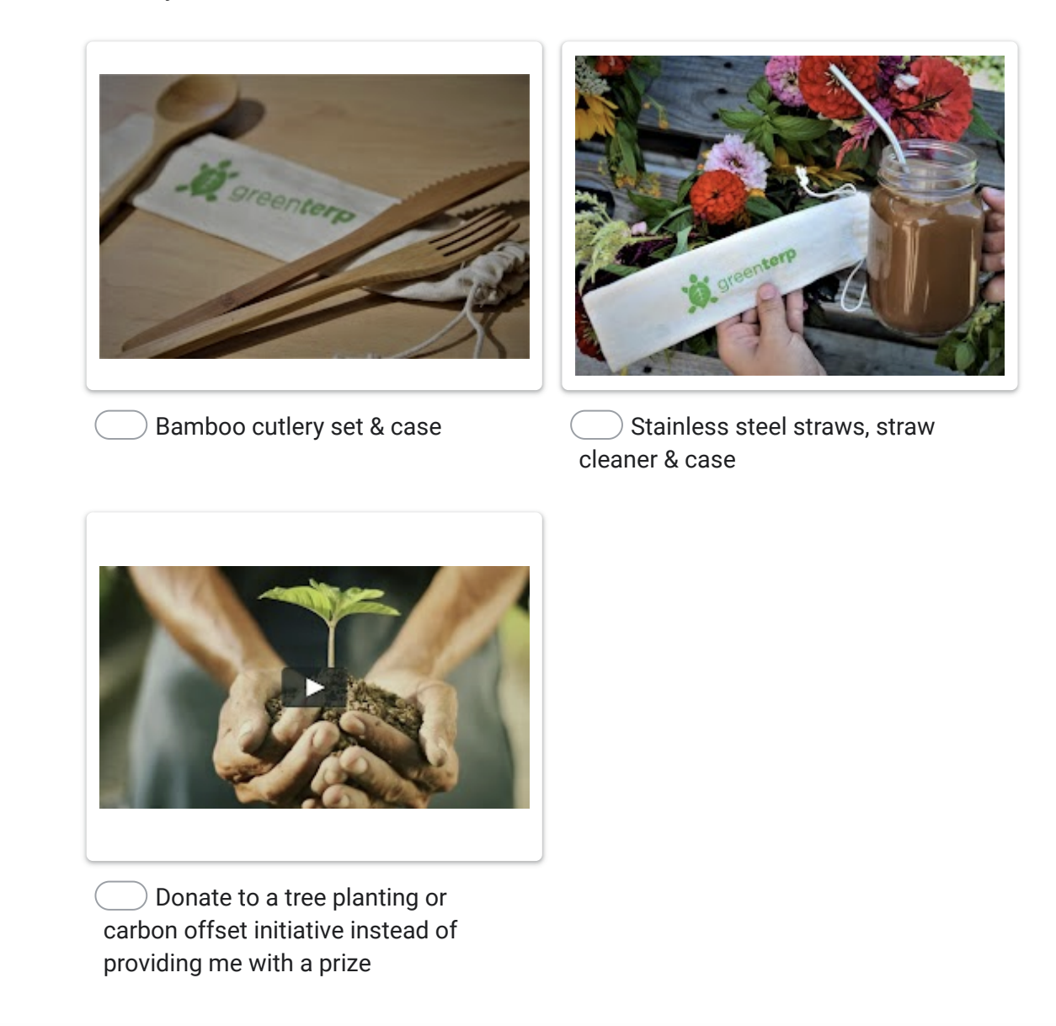
2022-2023

Slide 24
Source:
How can we maximize our registration and completion? Who should we focus on? How to get more registration? Where can we promote Green Terps?

Slide 25
Get a gift if you complete the certification !!!
2352 students have got gifts !!!

Slide 26
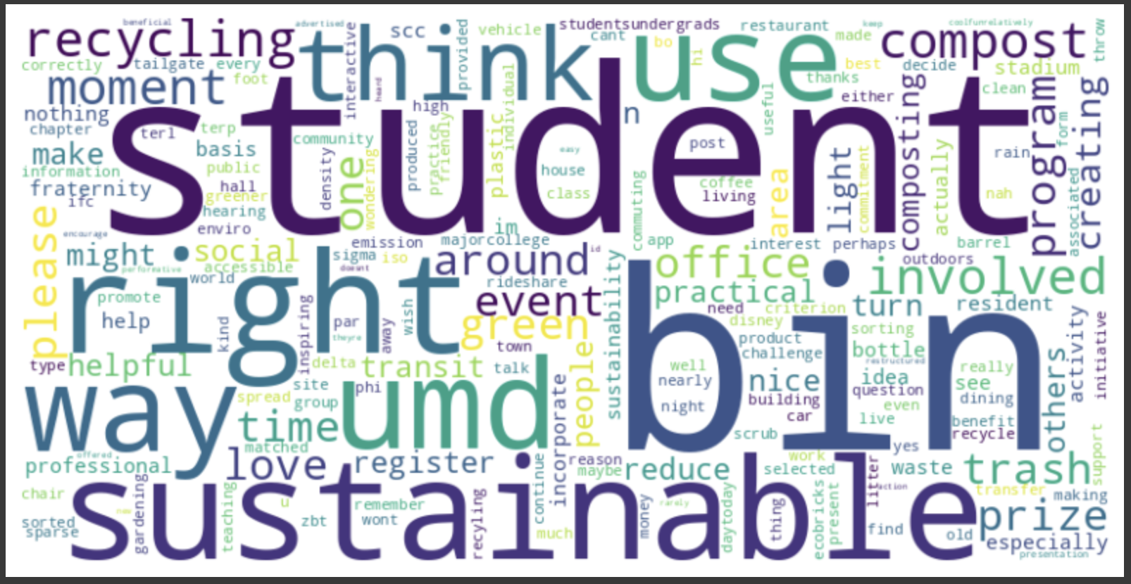
Suggestions:
Word cloud for Suggestions that students gave :

Slide 27

THANK YOU !
ANY QUESTION ???

